Slide 1
NAACP Parents’ Council Agenda
24 September 2025
** Parts of this meeting are being video recorded**
  6:10 pm –– Informal Networking “Meet n Greet” - All
  6:30 pm –– Welcome, Introductions, Agenda, Norms - Byron Johns, NAACP PC
  6:40 pm –– Grant Services - Diego Uriburu, Identity
  6:50 pm –– Unpacking Literacy & Math Assessment Data - Stephanie Brant, Kecia Addison, MCPS
7:30 pm –– Plans to Improve Special Education Services - Lisa Gaillard-Jones,
Tyre Jenkins, MCPS
  7:55 pm –– Tracking Upcoming Program Deadlines - Jeannie Franklin, MCPS
  8:00 pm –– Parents’ Council Real-Time Communications - Kea Anderson & PC Reps
  8:10 pm –– Next Steps & Closing - Byron

Slide 2
Welcome to all our New and Returning NAACP-MC Parents’ Council Reps!
School Level/Experience | Count
Elementary School | 94
New | 38
1 year | 22
2 years | 18
3 or more years | 16
High School | 27
New | 7
1 year | 3
2 years | 1
3 or more years | 16
Middle School | 37
New | 16
1 year | 4
2 years | 3
3 or more years | 14
Not Applicable | 30
New | 13
1 year | 1
3 or more years | 16
Grand Total | 188

Slide 3
What’s On Your Mind?
First Name | Organization/School | Comments/Questions | School Level
Yolanda | Northwest High School | As a new rep at NWHS, it has been difficult trying to establish support and guidance. Does the parent reps fall under the PTSA? | High School
Whitney | S. Christa McAuliffe | Can I get more information about our role in planning the trip to the Smithsonian so I can share with my school | Elementary School
Martine | Kingsview Middle School and Ronald McNair | Can we discuss the new grading system and how does it affect our students? | Middle School
Shantal | Somerset Elementary | DEI/NAACP Rep | Elementary School
Uchenwa | SCMS | explore ways to support my child | Middle School
Aditi | Woodfield Elemenary | For those of us new, can you walk through the logistics of the trip to the musuem? | Elementary School
nichelle | quince orchard high school | Getting threats on black lives out and coordinating protection against the threats. Hanging of black student on campus | High School
Ryan | Viers Mill PTA | Has there been equal representation in boundary study and program study feedback | Elementary School
Angela | Kingsview MS | How do we connect to get math tutoring up county | Middle School
Chiquita | Walter Johnson | how do we help our kids under this current admistration? | High School
Keight | Cloverly | How will the new literacy and math policies impact students with IEPs | Elementary School
Janice | African American Chamber of Commerce of Montgomery County, Inc | How would you improve school for High School students? | High School
Sarah Jane | Herbert Hoover | I would love to learn more about how to get involved | Middle School
Tonda | Wisdom In Minutes | if you need panelists or speakers on career readiness for parents nurturing teens I can help | Not Applicable
Terry | Stedwick Elementary | Interested in the availability of the IEP/504 plans and student peer tutoring | Elementary School
Daniela | Beall ES | Is it up to each school to decide what holidays are celebrated and how they are celebrated? Specifically Black History Month | Elementary School
Aisha | Richard Montgomery | It would be good to focus on high schools more often | High School
Kim | College Gardens Elementary | Looking forward to discussing the latest on the boundary study and program analysis | Elementary School
First Name | Organization/School | Comments/Questions | School Level
Jaclyn | Wayside Elementary | Looking forward to learning more on how to get our program up and running! | Elementary School
R | Waters Landing ES | Math teachers should routinely provide (without parents asking) module #/unit # and lesson numbers to parents. | Elementary School
Wanda | NAACP PARENTS COUNCIL | Test Scores | Not Applicable
Sarah | Bannockburn Elementary School | Upcoming events for the Whitman cluster. | Elementary School
Candace | Shady Grove MS | Was PC Rep at the elementary school and I would like to stay in the loop. | Middle School
Tyvae | Rock View ES | What is my direct role in relation to the school? | Elementary School
Ashley | Silver Spring International Middle School | What is the plan to increase services such as tutoring to help with math and english? | Middle School
jacqueline | wayside | what should a Rep do to help the school | Elementary School
Jessica | Lakelands Park | What should parents be aware of with the boundary study? How is equity being addressed in the redistricitng | Middle School
Zoporiah | Rocky Hill Middle School | What steps are being taken to help the students adjust to the new curriculum? and all who are impacted by the change? | Middle School
Anne | Thomas W. Pyle Middle School | What's the status of the boundary study? | Middle School
Carla D | NA | Which schools do not have reps? | Not Applicable
Ansalan | Bayard Rustin ES | Why aren’t MCAP reports sent yearly to parents, especially since used to determine eligibility for MCPS special programs? | Elementary School

Slide 4

Link to Presentation

Slide 5

Link to Presentation

Slide 6
Upcoming Registration Deadlines
Jeannie Franklin

Slide 7
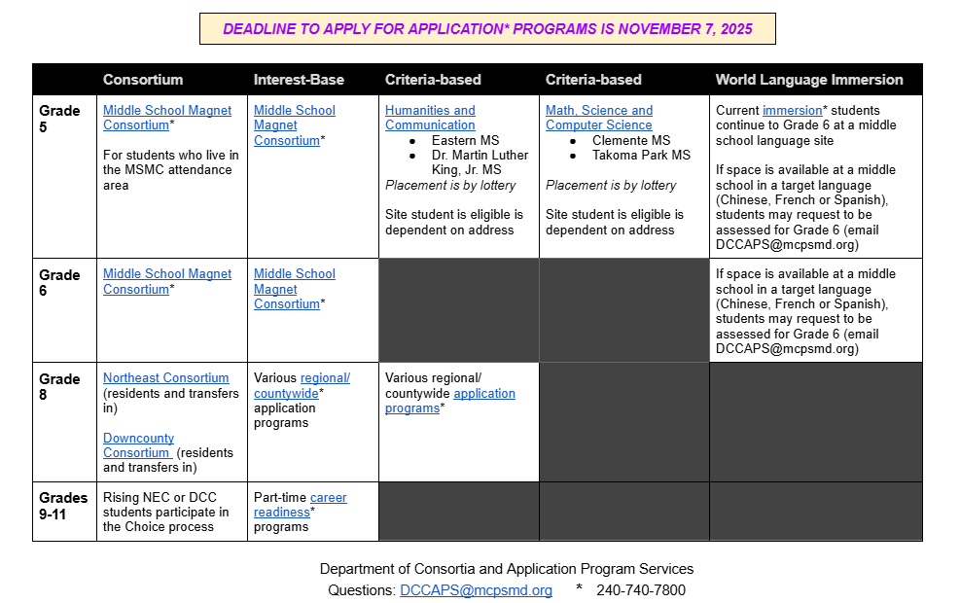

Slide 8
Parents’ Council Communications
Kea Anderson

Slide 9
Parents’ Council WhatsApp Groups
Main group for all PC reps:
https://chat.whatsapp.com/CT32A0g5kg08E7g6myEsLu?mode=ems_copy_c
Elementary School Reps:
https://chat.whatsapp.com/LLYMlDTn1hNCtYzuf3Gl8b?mode=ems_copy_c
Middle School Reps:
https://chat.whatsapp.com/FXsTMaktkzCAKQEjEx1Fiz?mode=ems_copy_c
High School Reps:
https://chat.whatsapp.com/LTtnCjQervBATYryD49iZi?mode=ems_copy_c

Slide 10

APPENDIX

Slide 11
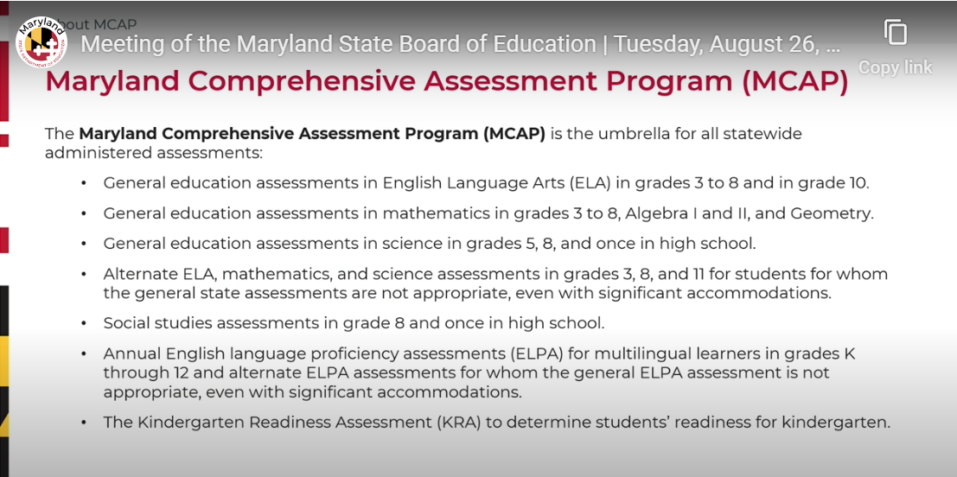

Slide 12
MCPS SY2024-25 MCAP Literacy & Math Results for Black/African American students

Slide 13
Year | LEA Name | School Name | Assessment | Student Group | Tested Count | Proficient Count | Proficient Pct | Level 1 Pct | Level 2 Pct | Level 3 Pct | Level 4 Pct | Create Date
2025 | Montgomery | All Montgomery Schools | English Language Arts 03 | Black/African American | 2321 | 1103 | 47.5 | 6.1 | 46.4 | 44.4 | <= 5.0 | 20250808
2025 | Montgomery | All Montgomery Schools | English Language Arts 04 | Black/African American | 2378 | 1075 | 45.2 | 10.1 | 44.7 | 39.0 | 6.2 | 20250808
2025 | Montgomery | All Montgomery Schools | English Language Arts 05 | Black/African American | 2486 | 1071 | 43.1 | 11.3 | 45.6 | 40.1 | <= 5.0 | 20250808
2025 | Montgomery | All Montgomery Schools | English Language Arts 06 | Black/African American | 2502 | 1207 | 48.2 | 7.4 | 44.3 | 44.1 | <= 5.0 | 20250808
2025 | Montgomery | All Montgomery Schools | English Language Arts 07 | Black/African American | 2428 | 1225 | 50.5 | 6.3 | 43.3 | 46.2 | <= 5.0 | 20250808
2025 | Montgomery | All Montgomery Schools | English Language Arts 08 | Black/African American | 2499 | 1089 | 43.6 | 12.9 | 43.5 | 40.9 | <= 5.0 | 20250808
2025 | Montgomery | All Montgomery Schools | English Language Arts 10 | Black/African American | 2806 | 1644 | 58.6 | 5.1 | 36.3 | 50.6 | 8.0 | 20250808
2025 | Montgomery | All Montgomery Schools | English Language Arts 3-5 | Black/African American | 7185 | 3249 | 45.2 | 9.2 | 45.5 | 41.1 | <= 5.0 | 20250808
2025 | Montgomery | All Montgomery Schools | English Language Arts 3-8 | Black/African American | 14614 | 6770 | 46.3 | 9.1 | 44.6 | 42.4 | <= 5.0 | 20250808
2025 | Montgomery | All Montgomery Schools | English Language Arts 6-8 | Black/African American | 7429 | 3521 | 47.4 | 8.9 | 43.7 | 43.7 | <= 5.0 | 20250808
2025 | Montgomery | All Montgomery Schools | English Language Arts All Grades | Black/African American | 17420 | 8414 | 48.3 | 8.4 | 43.3 | 43.7 | <= 5.0 | 20250808
MCPS MCAP
Scores from SY 2024-2025
Year | LEA Name | School Name | Assessment | Student Group | Tested Count | Proficient Count | Proficient Pct | Level 1 Pct | Level 2 Pct | Level 3 Pct | Level 4 Pct | Create Date
2025 | Montgomery | All Montgomery Schools | Mathematics 03 | Black/African American | 2375 | 964 | 40.6 | 20.5 | 38.9 | 38.0 | <= 5.0 | 20250808
2025 | Montgomery | All Montgomery Schools | Mathematics 04 | Black/African American | 2416 | 784 | 32.5 | 19.7 | 47.8 | 30.3 | <= 5.0 | 20250808
2025 | Montgomery | All Montgomery Schools | Mathematics 05 | Black/African American | 2532 | 769 | 30.4 | 15.3 | 54.3 | 29.3 | <= 5.0 | 20250808
2025 | Montgomery | All Montgomery Schools | Mathematics 06 | Black/African American | 2524 | 463 | 18.3 | 29.6 | 52.1 | 17.8 | <= 5.0 | 20250808
2025 | Montgomery | All Montgomery Schools | Mathematics 07 | Black/African American | 2043 | 157 | 7.7 | 50.6 | 41.8 | 7.5 | <= 5.0 | 20250808
2025 | Montgomery | All Montgomery Schools | Mathematics 08 | Black/African American | 1348 | * | <= 5.0 | 51.4 | 46.2 | <= 5.0 | <= 5.0 | 20250808
2025 | Montgomery | All Montgomery Schools | Mathematics 3-5 | Black/African American | 7323 | 2517 | 34.4 | 18.4 | 47.2 | 32.4 | <= 5.0 | 20250808
2025 | Montgomery | All Montgomery Schools | Mathematics 3-8 | Black/African American | 13238 | 3169 | 23.9 | 28.9 | 47.2 | 22.7 | <= 5.0 | 20250808
2025 | Montgomery | All Montgomery Schools | Mathematics 6-8 | Black/African American | 5915 | 652 | 11.0 | 41.8 | 47.2 | 10.7 | <= 5.0 | 20250808
2025 | Montgomery | All Montgomery Schools | Algebra 1 | Black/African American | 2386 | 364 | 15.3 | 24.1 | 60.6 | 15.1 | <= 5.0 | 20250808
2025 | Montgomery | All Montgomery Schools | Algebra 2 | Black/African American | * | * | * | * | * | * | * | 20250808
2025 | Montgomery | All Montgomery Schools | Geometry | Black/African American | 377 | 135 | 35.8 | 8.2 | 56.0 | 33.7 | <= 5.0 | 20250808
2025 | Montgomery | All Montgomery Schools | Mathematics All Grades | Black/African American | 16010 | 3672 | 22.9 | 27.7 | 49.4 | 21.9 | <= 5.0 | 20250808

Slide 14
Maryland Statewide SY2024-25 MCAP Results

Slide 15
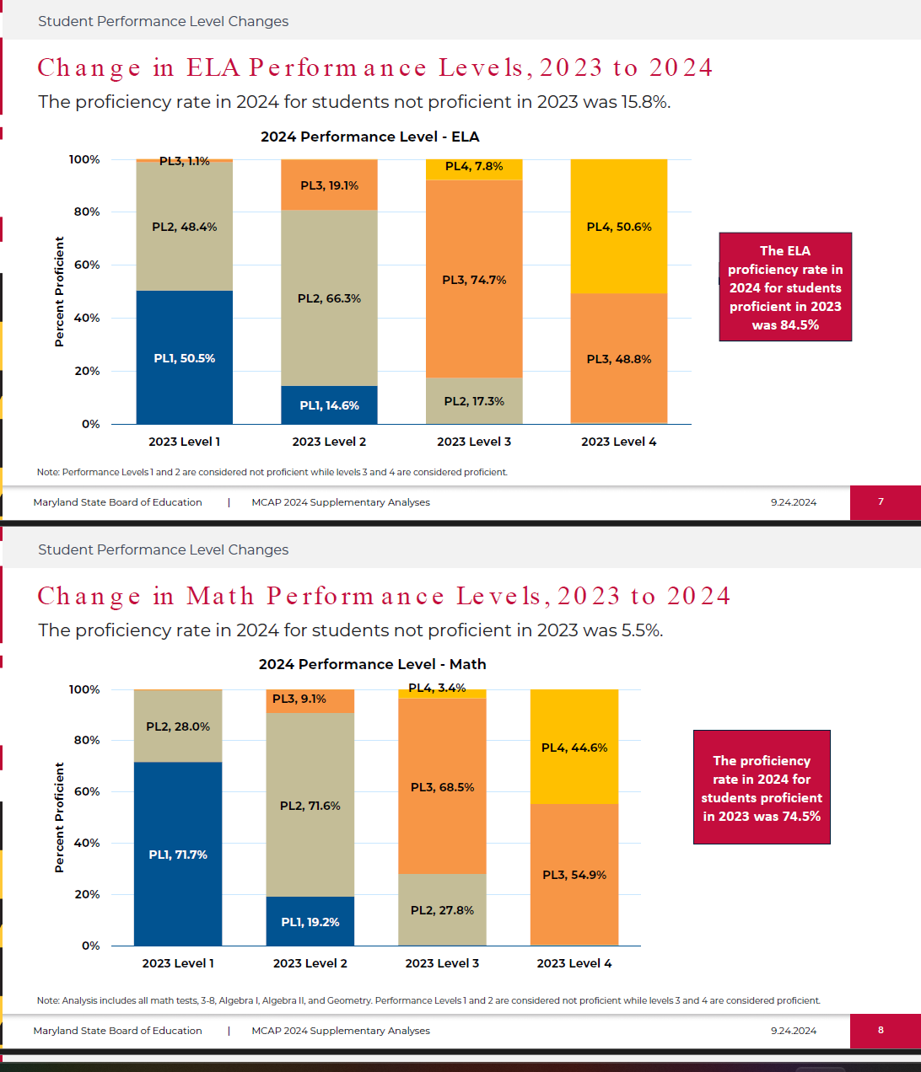

Slide 17
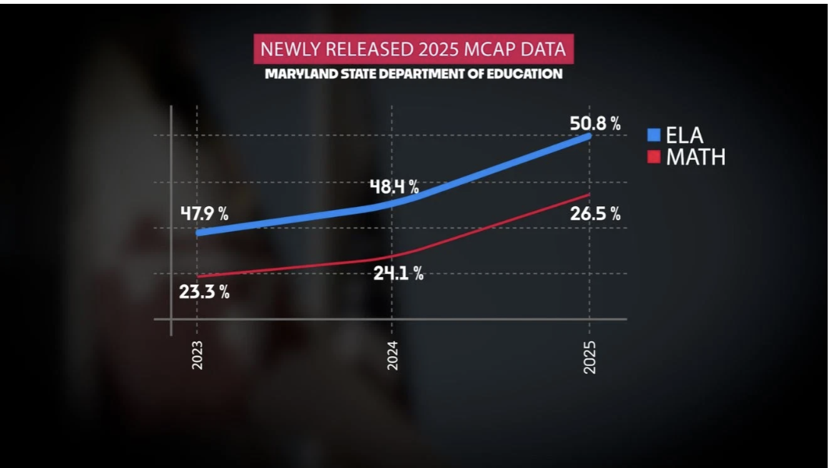

Slide 18
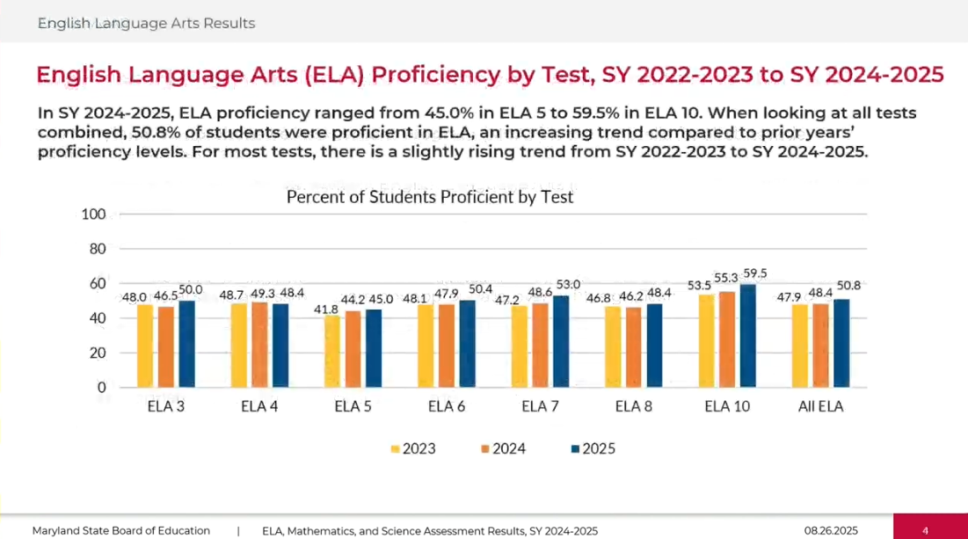

Slide 19
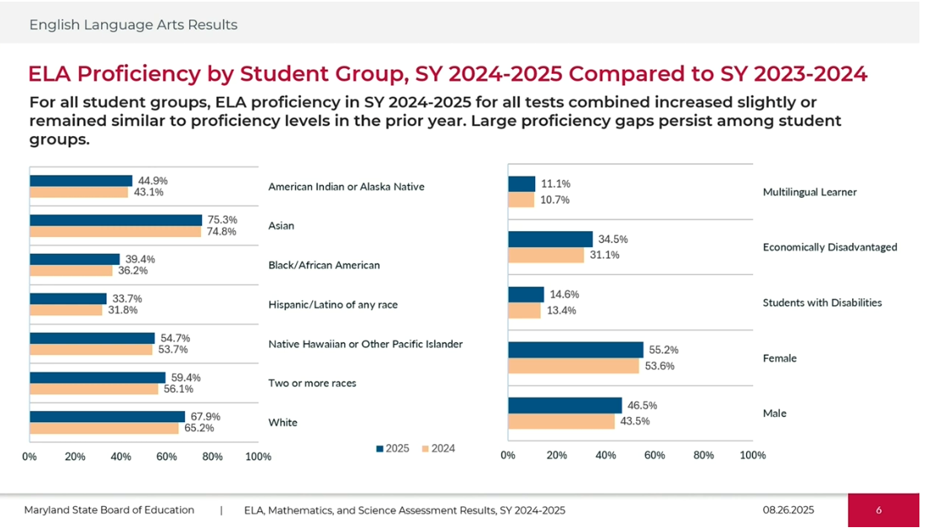

Slide 20
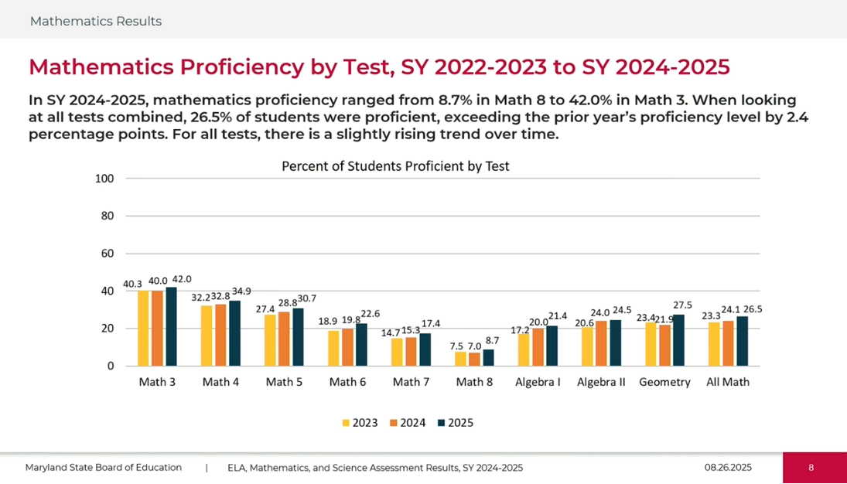

Slide 21
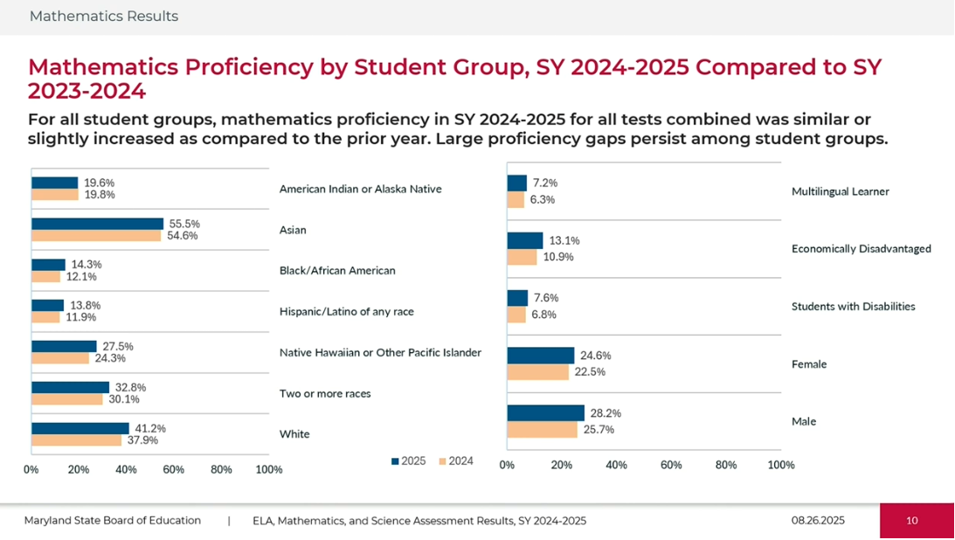

Slide 22
MCPS SY2024-25 MCAP Results for Black/African American students

Slide 23
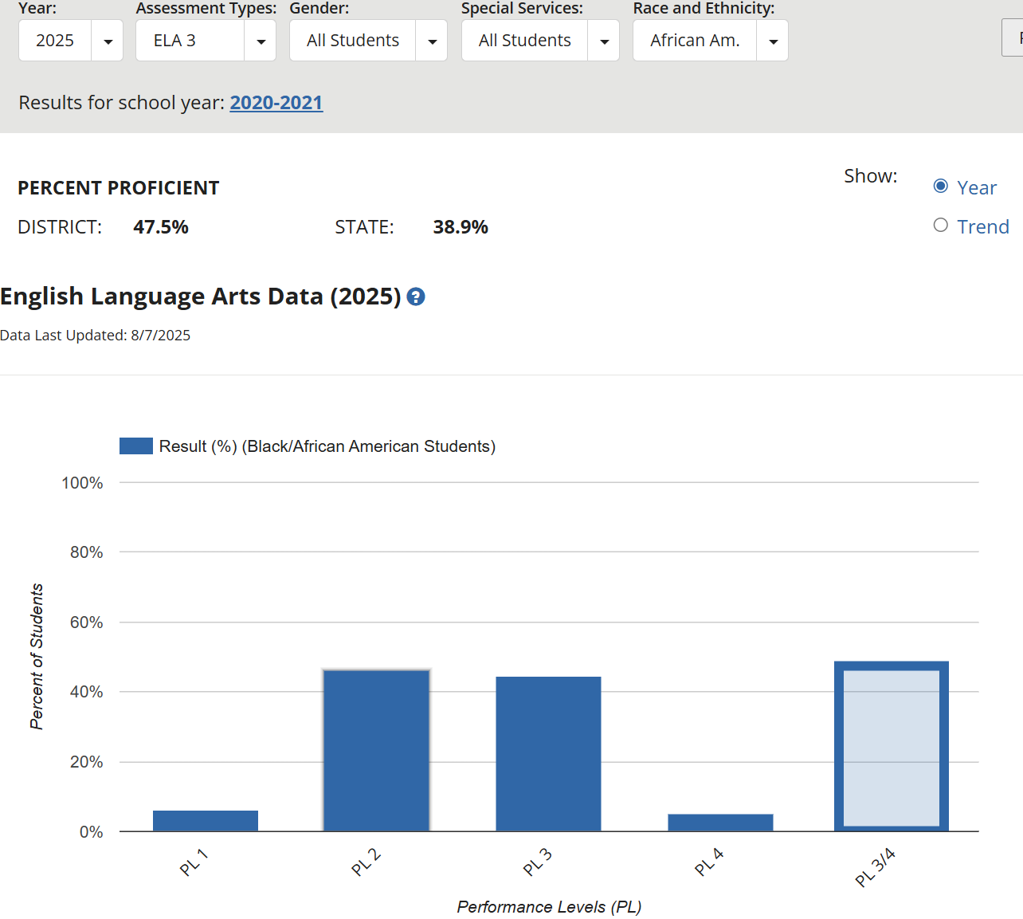
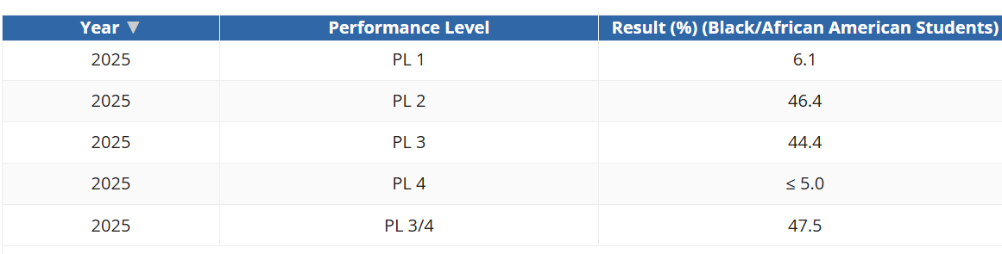
MCPS 2025 MCAP Literacy Results for Grade 3 Black/African American

Slide 24
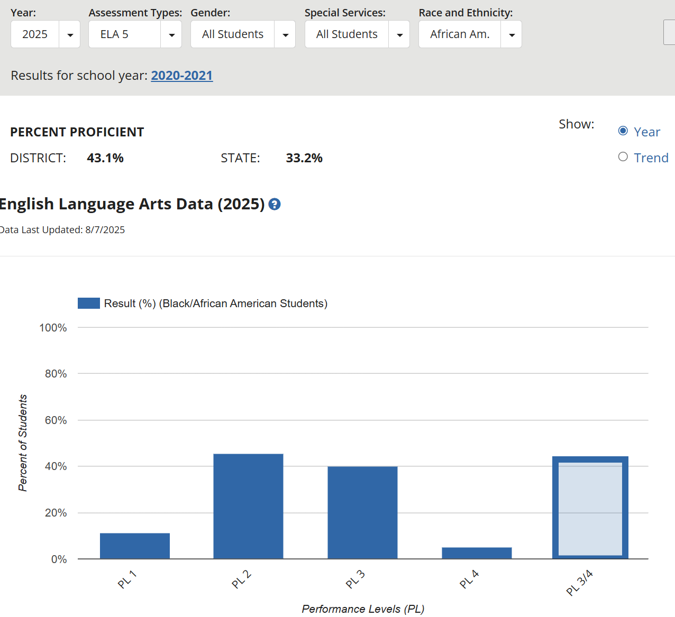
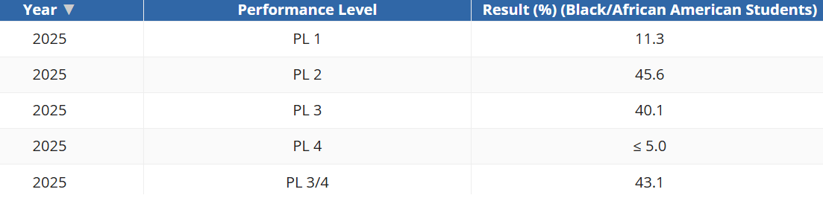
MCPS 2025 MCAP Literacy Results for Grade 5 Black/African American

Slide 25
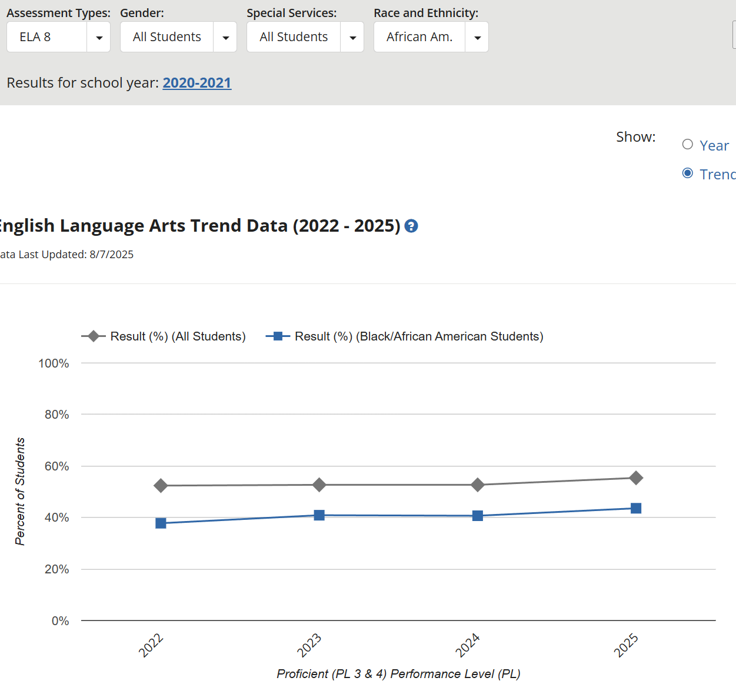
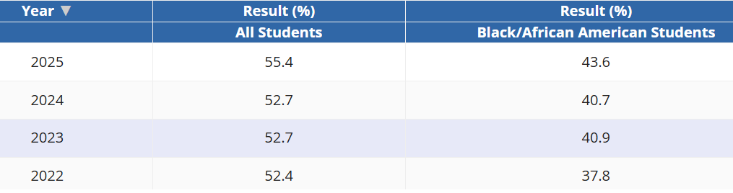
MCPS 2025 MCAP Literacy Trend for Grade 8 Black/African American

Slide 26
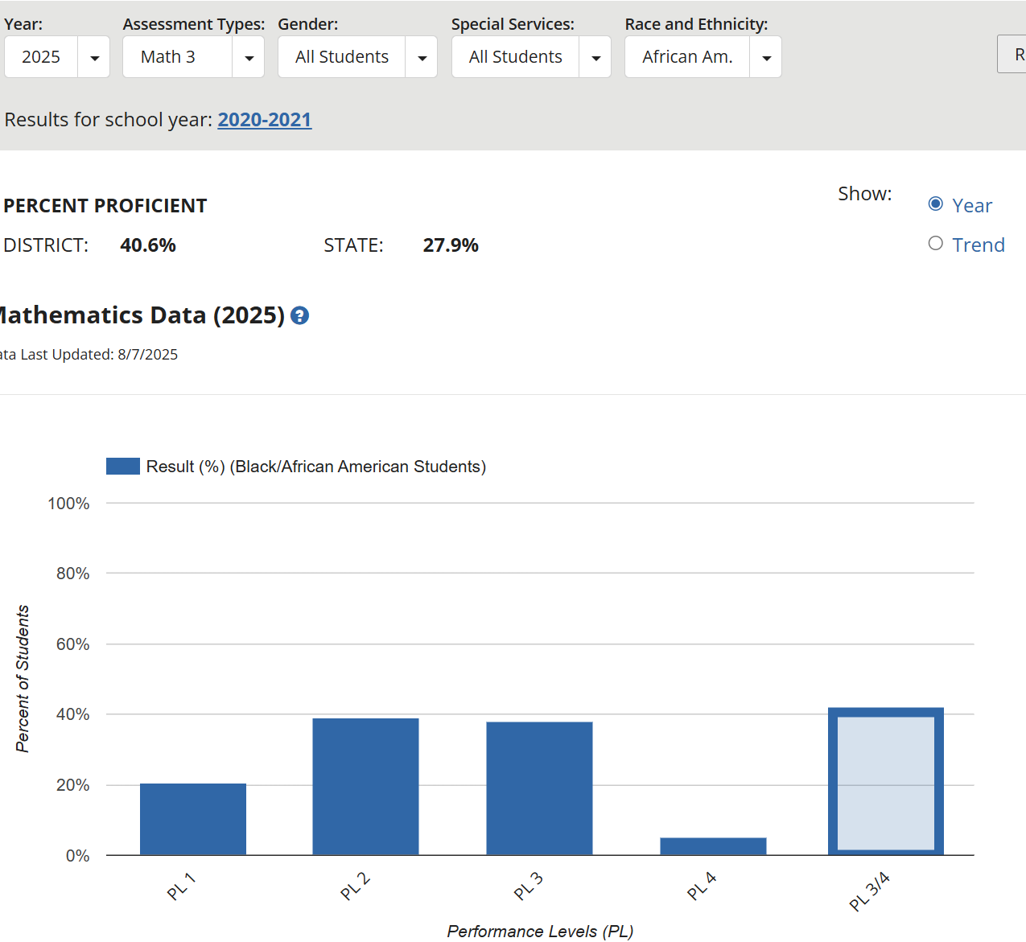
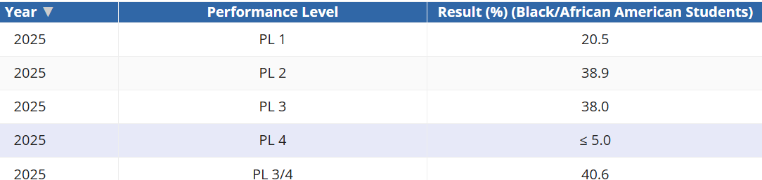
MCPS 2025 MCAP Math Results for Grade 3 Black/African American

Slide 27
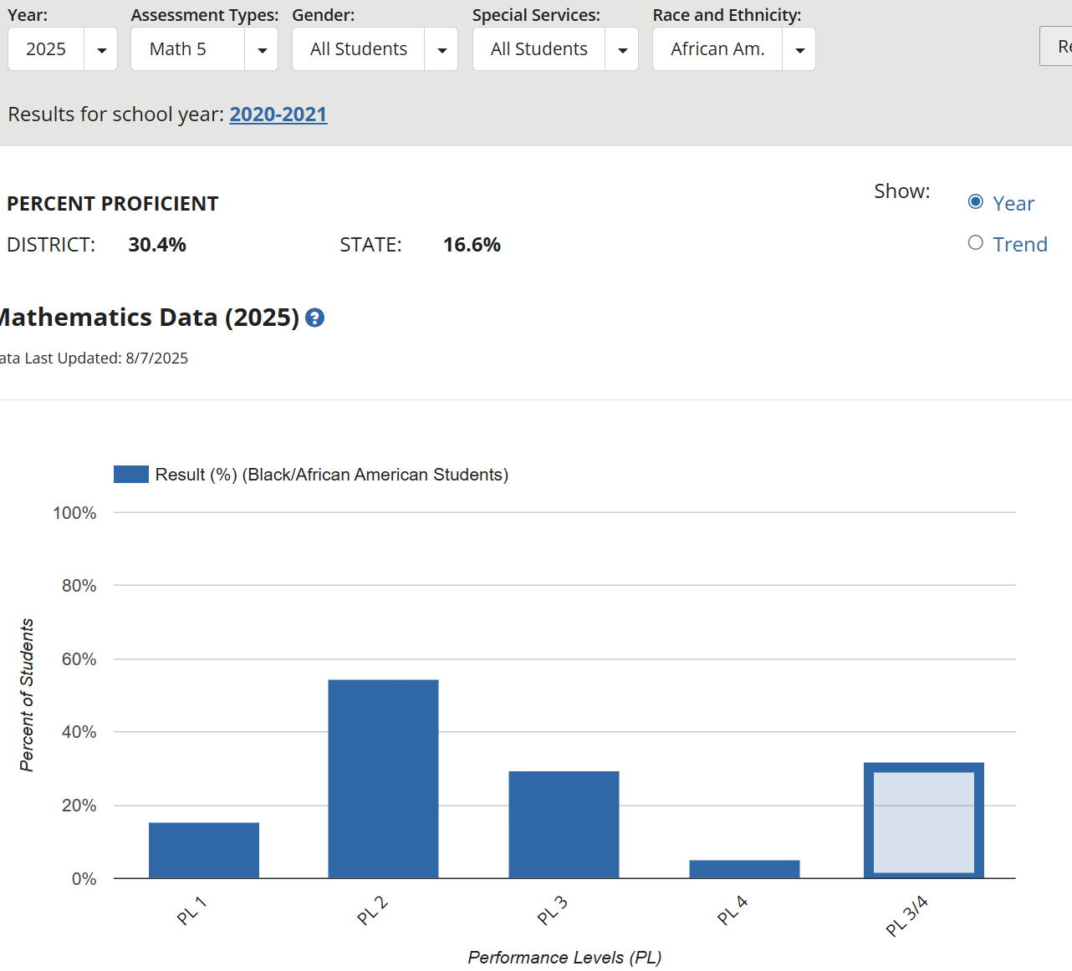
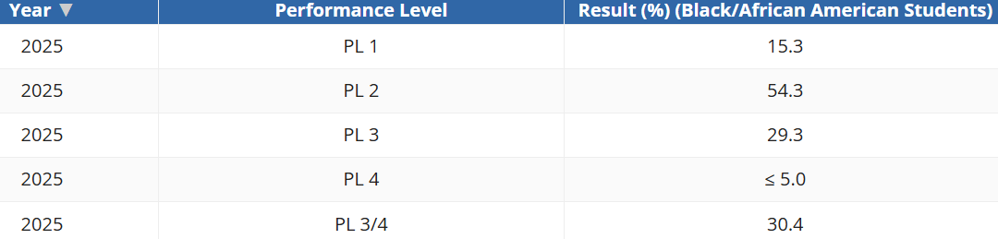
MCPS 2025 MCAP Math Results for Grade 5 Black/African American

Slide 28
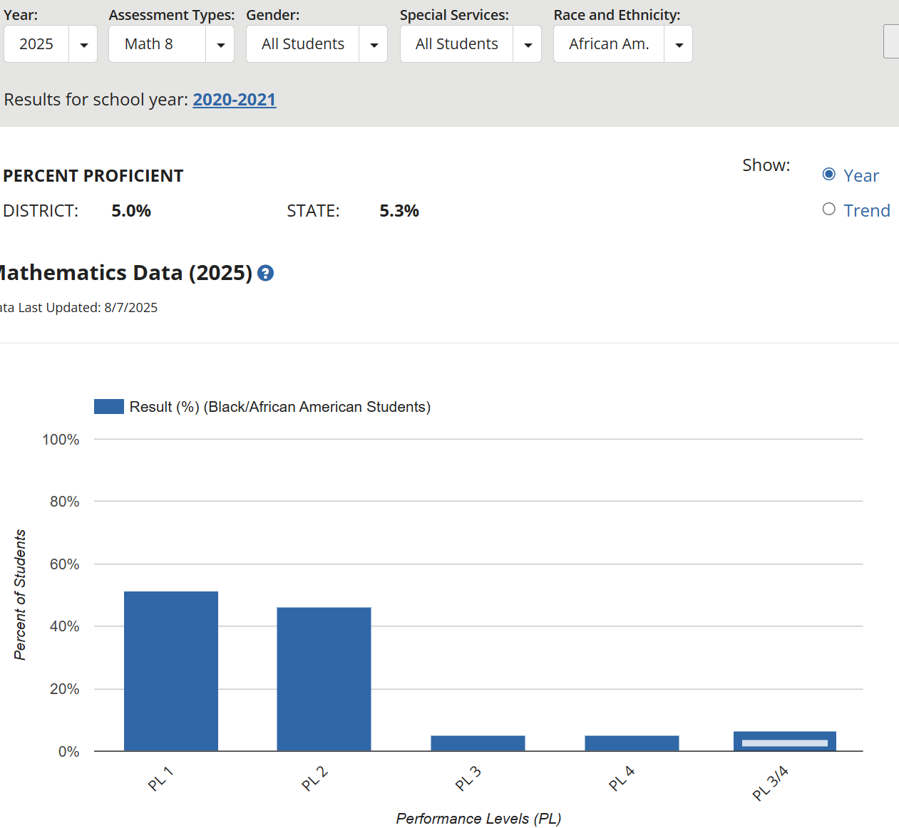
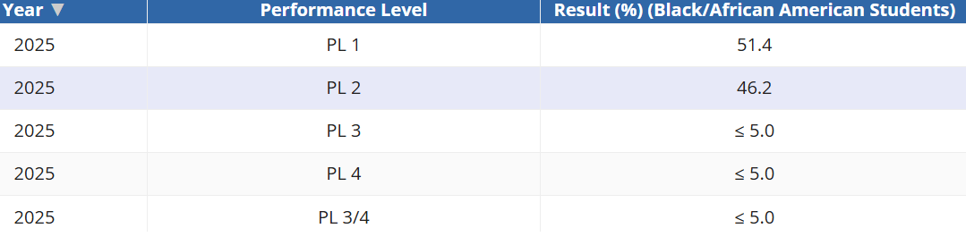
MCPS 2025 MCAP Math Results for Grade 8 Black/African American

Slide 29
2025 MSDE MCAP Data
https://reportcard.msde.maryland.gov/Graphs/#/DataDownloads/datadownload/3/17/6/99/XXXX/2025
MCAP Practice Tests
https://support.mdassessments.com/practice-tests/

Slide 30
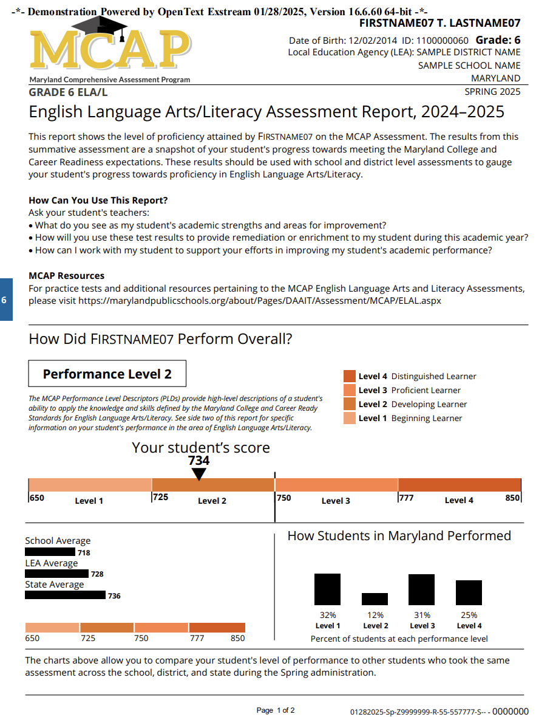
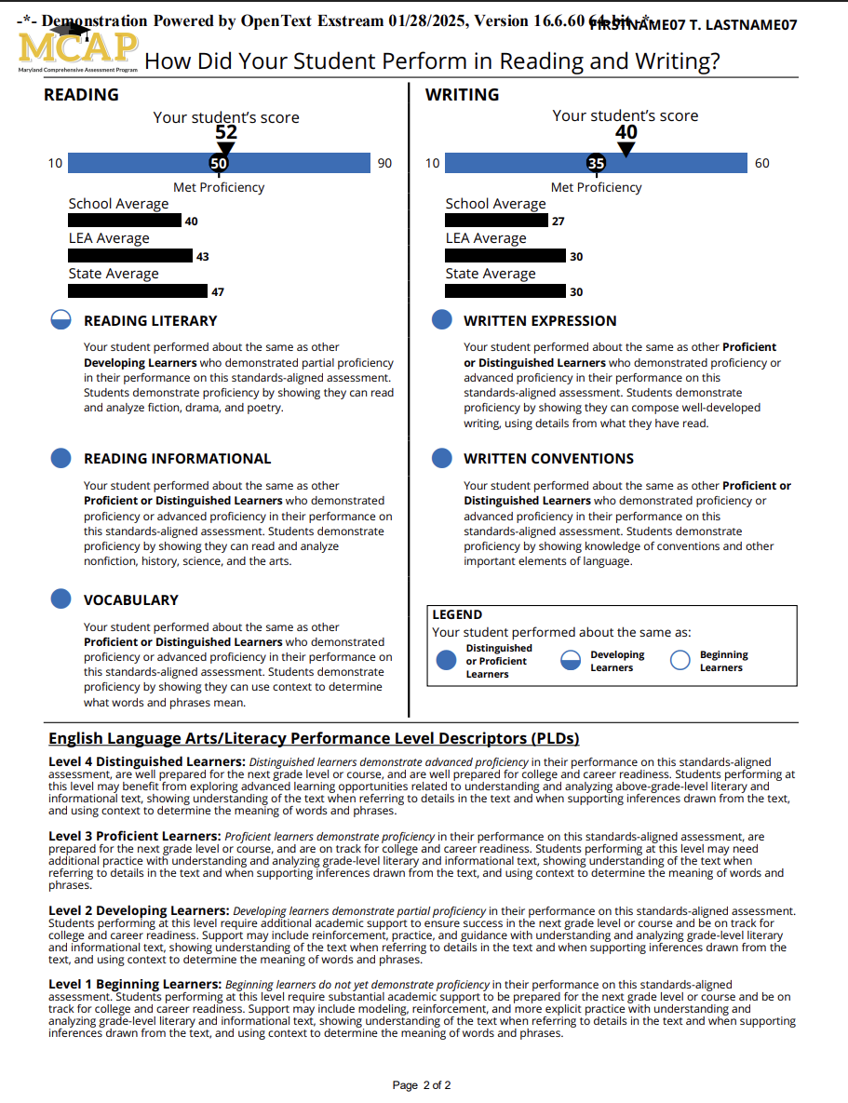
Expect Your Student’s Paper MCAP Report by Mid-October

Slide 31
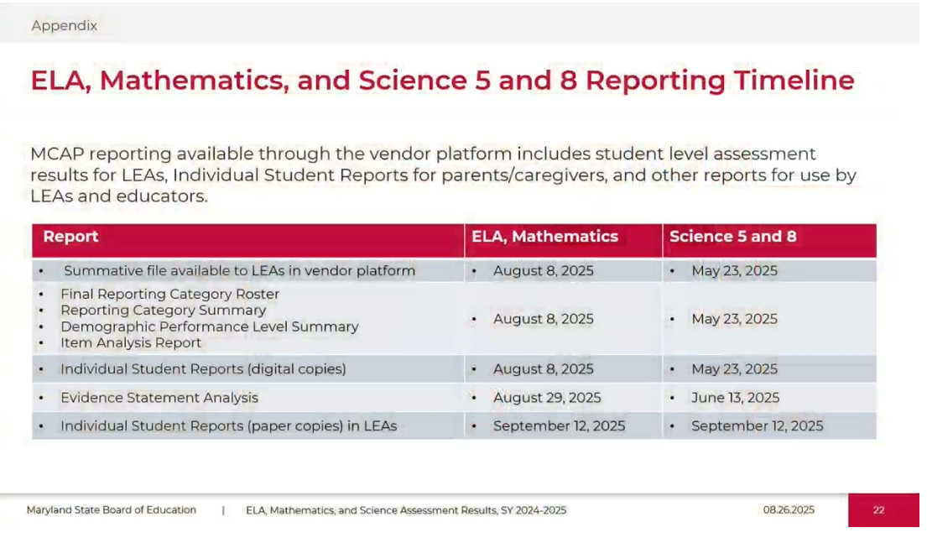

Slide 32
MCPS Elementary & Middle School 2024-25 MAP-M Analysis
Black and Brown Coalition for Educational Equity and Excellence
August12, 2025

Slide 33
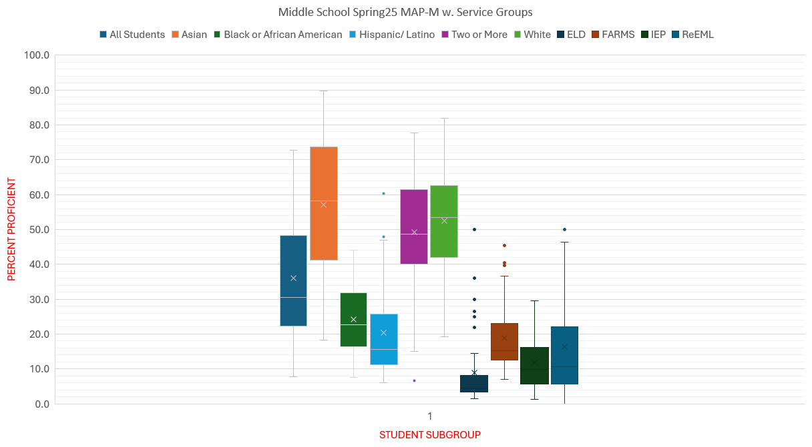
All schools show Black & Brown students well below 50%

Slide 34
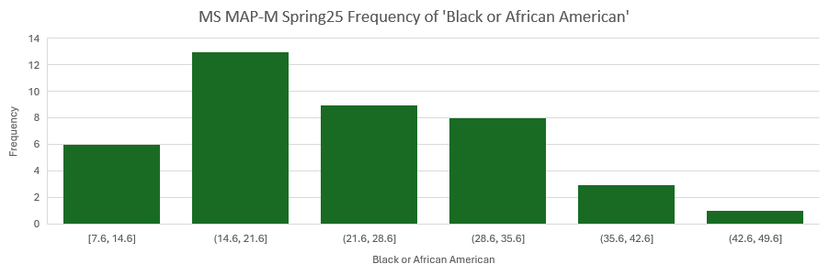
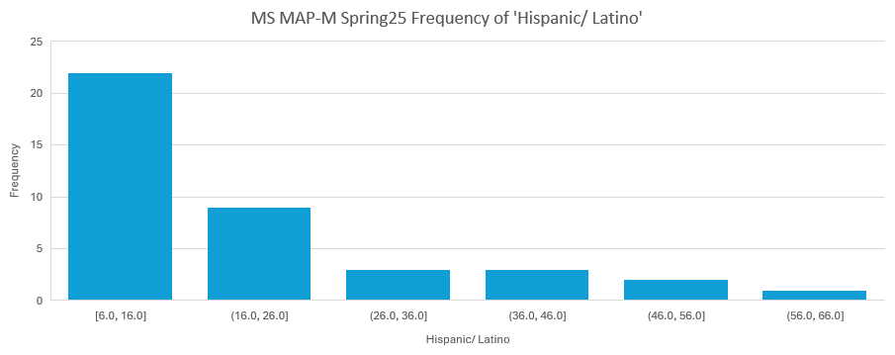
13 schools had between 14.6% & 21.6% pass
22 schools had <16% pass

Slide 35
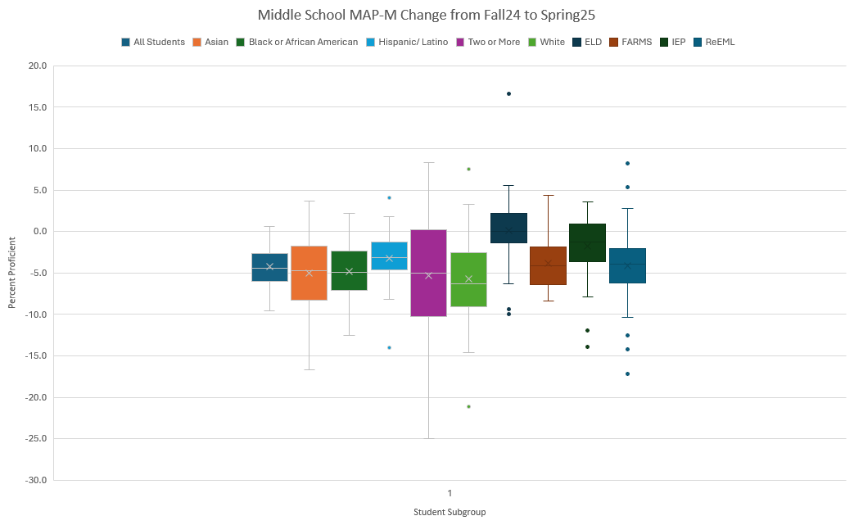
Most Schools show
A DECLINE in Proficiency from Fall to Spring last year

Slide 36
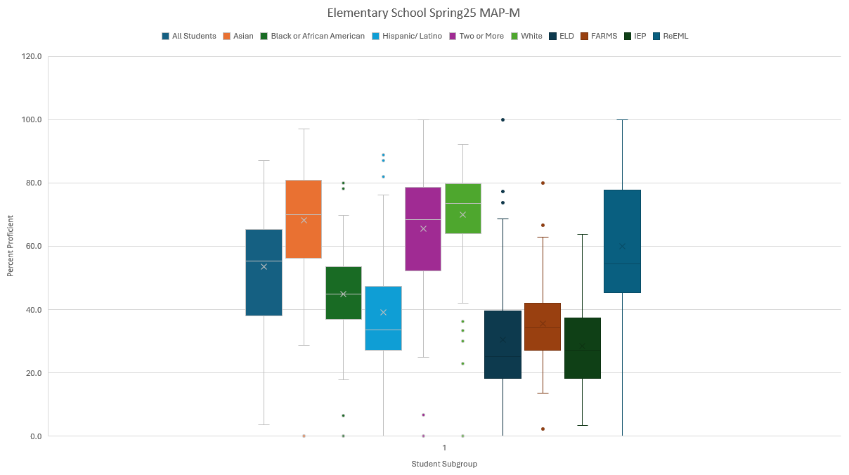
Elementary Schools show a higher but similar
Pattern in Proficiency across subgroups

Slide 37
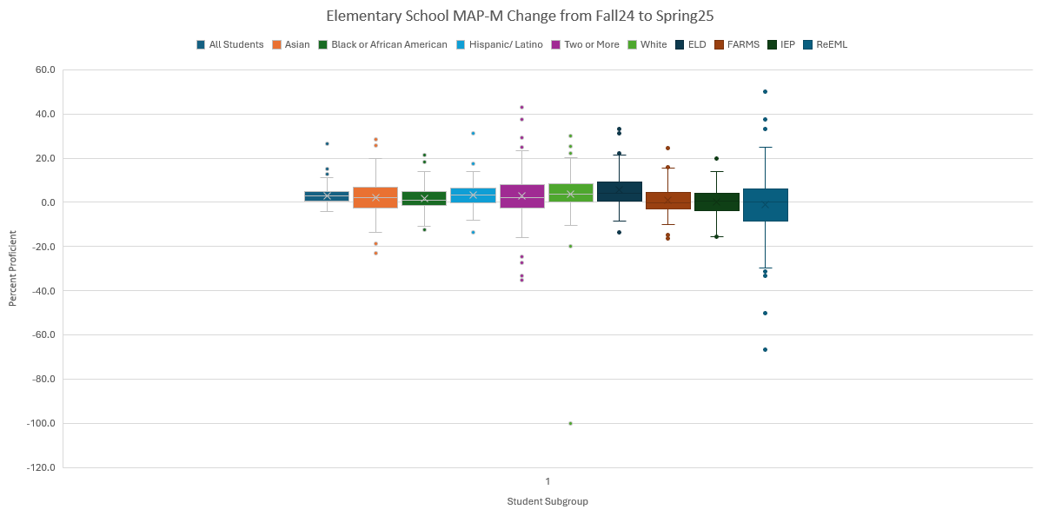
Elem Schools show
Slight Gains in Proficiency from Fall to Spring

Slide 38
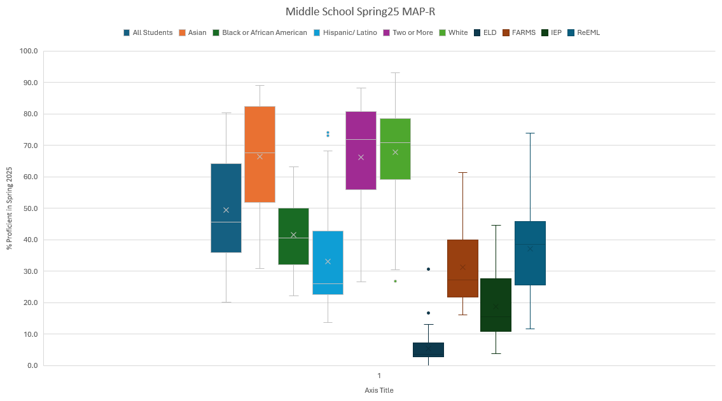

Slide 39
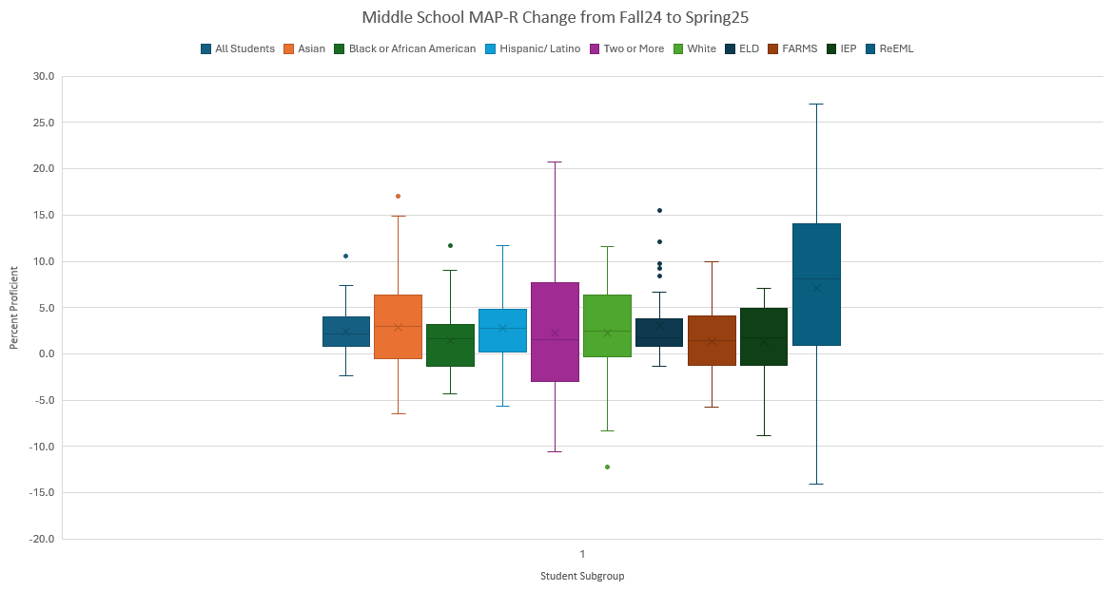

Slide 40
Parent Advocacy
Parent advocacy plays a crucial role in shaping the educational landscape, from individual interventions to collective movements for systemic change.
The Moral Arc of the Universe May Bend Towards Justice, But It Doesn’t Bend Itself!

Slide 41

Click for Presentation

Slide 42
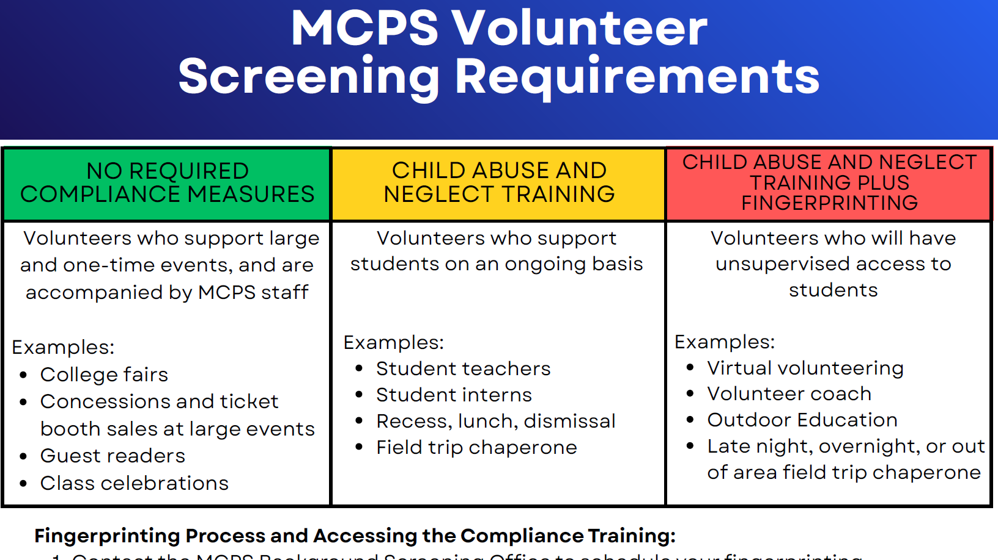

Slide 43

Black History Month
Field Trips to
National Museum of African American History and Culture

Slide 44
Field Trip:
National Museum of African American History and Culture
Who? Montgomery County Public Schools each plan Field Trips for students (1 chaparone per 10 students)
What? Participate in community-wide effort to honor African American contributions toward history
When? February 01, 2024 - February 29, 2025
Where? NMAAHC, 1400 Constitution Ave. NW, Washington, DC 20560
Why? Cultural Identity, Education, Enrichment & Experiential Learning Excursion
Last Year

Slide 45
2025 NMAAHC Field Trip Interested Schools
(30 schools as of 14November)
Arcola Elementary School
Burnt Mills ES
Cabin Branch ES
Chevy Chase Elementary
DuFief E.S.
Fields Road Elementary School
Forest Oak Middle School
Gaithersburg High School
Greencastle Elementary School
Hallie Wells Middle School
Kensington Parkwood Elementary School
Little Bennett Elementary School
Newport Mill MS
Parkland Magnet Middle School
Redland MS
Roberto Clemente Middle School
Rock Creek Forest Elementary School
Rock Creek Forest ES
Rockville High School
Sequoyah ES
Silver Spring International Middle School
Sligo Creek Elementary school
Strawberry Knoll ES
Thomas W. Pyle Middle School
Westland Middle School
Wheaton High School
Whetstone Elementary School
William Tyler Page Elementary School
Wilson Wims Elementary School
Wyngate elementary
Last Year

Slide 46
NAACP Parents’ Council
Resources
Become a Member of the NAACP https://naacp-mc.org/
Parents Council Webpage http://naacppc-md.org/
Hate/Bias Reporting Procedures https://www.dropbox.com/scl/fi/3woywhzdr7s00l9ioubvv/fy23_quick-reference-hate-bias-procedures.march-2023.pdf?rlkey=5jmlywi1k61yz8t7xta4il1oq&dl=0
NAACP Complaint Form https://www.dropbox.com/scl/fi/lg2y4gecocyjf2m4fe08u/Complaint-Form-NAACP.pdf?rlkey=rqjcozy5hu3dn826gil5e2aam&dl=0

